Slide 1
Embodied construction grammar
CSCTR Session 8
Dana Retová

Slide 2



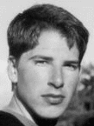
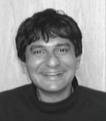

NTL
group at UC Berkeley
& Uni of Hawaii
  Nancy Chang
  Benjamin Bergen
  Jerome Feldman, …
General assumption
  Semantic relations could be extracted from language input
“In its communicative function, language is a set of tools with which we attempt to guide another mind to create within itself a mental representation that approximates one we have.” (Delancey 1997)

Slide 3
Language
Listener and speaker have to share enough experience
Language can be expressed by a discrete set of parameters and by semantic relations among entities and actions.
  How these relations are encoded in the sequences of letters and sounds?

Slide 4

3 mechanisms for conveying a semantic relation
A word that conveys some meaning
  “in, on, through”
Word order
  “red fire engine” vs. “fire engine red”
Some change in a base word
  -”ed” ending for the past tense
  Systematic change in spelling (“car”-> “cars”)
  Converting a verb to a noun (“evoke”->”evocation”)

Slide 5
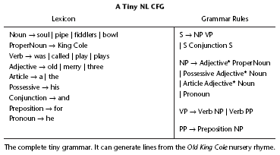
Context Free Grammar
Notes:
Lexicon – lists the grammatical type of all possible words for this fragment
| symbol = “or”
Grammar rules – specify how to build larger grammatical constructions from smaller ones.
E.g. first rule: A sentence (s) can be a noun phrase (NP) followed by a verb phrase (VP) or it can be a smaller S, followed by a Conjunction followed by a second smaller S.

Slide 6
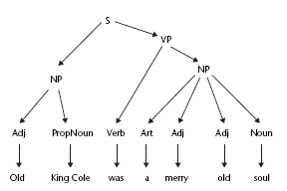
Analysis of simple sentence by CFG
Notes:
According to this grammar sentence “Old King Cole was a merry old fiddlers” is okay but to us it is not…
On the other hand “Virginia thinks vanilla” is ungrammatical but okay following “What flavor of ice cream does Georgia want?”
“Old King Cole was a merry old fiddlers”
Problem with only last letter – number agreement
We would need to split SgArticle and PlArticle, SgNP and PlNP, verb
Number agreement is not the only problem, also person, case, gender agreement etc.
CFG treats all the verbs identically
Transitive verbs – need an object (“she played the pipe”)
Intransitive verbs – don’t (“she sleeps)”

Slide 7
Solution
S -> VP NP
  VP.person <-> NP.person
  VP.gender <-> NP.gender
  VP.number <-> NP.number
Notes:
“Old King Cole was a merry old fiddlers”
Problem with only last letter – number agreement
We would need to split SgArticle and PlArticle, SgNP and PlNP, verb
Number agreement is not the only problem, also person, case, gender agreement etc.
CFG treats all the verbs identically
Transitive verbs – need an object (“she played the pipe”)
Intransitive verbs – don’t (“she sleeps)”

Slide 8
What CFG cannot cover?
Context
  The meaning of indexicals
    “here”, “now”
  Referents of expressions
    “they”, “that question”
  Ambiguous sentences
    “Harry waked into the café with the singer”
  Metaphors
  Intonation (e.g. stress, irony,…)
    “HARRY walked into the café.”
    “Harry WALKED into the café.”
  Gestures
Notes:
Stressed word suggests a contrast set… walked as opposed to ran or crawled…

Slide 9
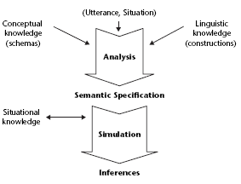
Language understanding
Notes:
Conceptual knowledge – includes universal schemas and cultural frames
Situational knowledge - system has to know something about the general situation
Constructions!!!
focus on how meanings of words are combined in larger linguistic units such as phrases, clauses, and sentences.
Still- meaning of an utterance can best be expressed as a linked set of embodied schemas.

Slide 10
Traditional theory
Meanings reside in words
  Each word has multiple fixed meanings – word senses
  Rules of grammar are devoid of meaning and only specify which combinations of words are allowed
Meaning of any combination of words can be determined by first detecting which sense of each word is involved and then using the appropriate rule for each word sense.
  “stone lion”
  Should each animal name like “lion” have another word sense covering animal-shaped objects
Notes:
Additional modifiers work this way for some objects,
but not for others. So a stone lion is not a lion, but a stone bridge is still a
Bridge.
Our main concern in this chapter is with how meanings are combined.
The simplest and still most widely accepted theory is that each word has
multiple fixed meanings, called word senses. In this theory, all meaning
resides in words; the rules of grammar are devoid of meaning and only
specify which combinations of words are allowed. Referring back to the
language wars, this position is part of the stance of autonomous syntax.
According to this view, the meaning of any combination of words can be
determined by first detecting which sense of each word is involved, and
then using the appropriate rule for each word sense. So, we understand
stone lion as referring to something made of stone that has the shape
of a lion.
There is a major problem in trying to define word sense meanings for
individual words that will lead to any such simple rules for the meaning
of word pairs. Should each animal name, like lion, have another word sense
covering lion-shaped objects?

Slide 11
NTL – alternative theory
Each word activates alternative meaning subnetwork
These subnetworks themselves are linked to other circuits representing the semantics of words and frames that are active in the current context.
The meaning of a word in context is captured by the joint activity of all of the relevant circuitry

Slide 12
Goal of NTL’s embodied grammar
To write down rules of grammar that are understandable by people and computer programs and that also characterize the way our brains actually process language
The job of grammar is to specify which semantic schemas are being evoked, how they are parameterized and how they are liked together in the semantic specification.
To formalize cognitive linguistics

Slide 13
Embodied construction grammar
Construction = pairing of linguistic form and meaning
  All levels of linguistic form (prefixes, words, phrases, sentences, stories, etc.) can be represented as mapping from some regularities of form to some semantic relations in the semantic specification
“embodied”
  Semantic part of a construction is composed of various kinds of embodied schemas
    Image
    Force dynamic
    action

Slide 14
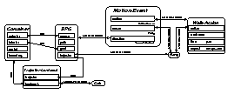
Simulation-based language understanding
construction WALKED
form
self_{f}.phon ← [wakt]
meaning : Walk-Action
constraints
self_{m}.time before Context.speech-time
self_{m}..aspect ← encapsulated
“Harry walked into the cafe.”
Utterance
Constructions
Analysis Process
General Knowledge
Semantic
Specification
Belief State
CAFE
Simulation
Notes:
Similar to what we’re doing today (not coincidentally). Utterances evoke a complex network of conceptual schemas that are simulated in context to produce a rich set of inferences.
BUT: entire process draws on many different kinds of data: constructions (lexical and grammatical, etc.), ontology, context. (We’re focusing on just a part of it today.)

Slide 15
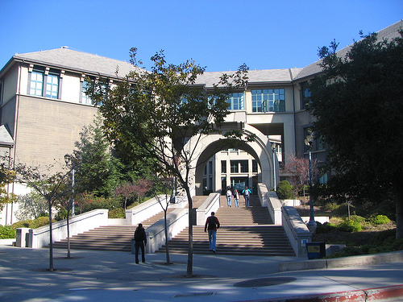
Example
“Harry strolled to Berkeley”
Individual word
  simplest construction (lexical)
  Lexical construction To |From
  subcase of Spatial Preposition
  evokes SPG as s
  form “to” |“from”
  meaning Trajector-Landmark
  lm <-> s.goal |lm <-> s.source
  traj <-> s.traj
Notes:
Constructions – link linguistic form to the meaning representation in form of semantic specification (which consists of linked schemas)
Meaning is based on source-path-goal schema
If construction is a subcase, it can by used wherever its parent can be used
Evokes mechanism – notation of the fact that concept often activates other related concepts.
Form (in this case very easy) – spelling out the word
Meaning – specifies the semantic schemas and relations
s.Goal – goal role of the particular schema s

Slide 16
Spatial Prepositional Phrases
Construction Spatial PP
subcase of Destination
constituents
r: Spatial Preposition
base: NP
form r < base
meaning
r.lm <-> base
In CFG: Spatial PP -> Spatial Preposition NP
Notes:
Crucial difference – semantics plays an equal role in ECG construction
when the spatial PP construction is applied, the meaning condition must be matched in addition to the form requirement.
e.g. the phrase “to Berkeley” would match as a spatial PP, leading to the bit of SemSpec which expresses motion of some sort toward Berkley

Slide 17
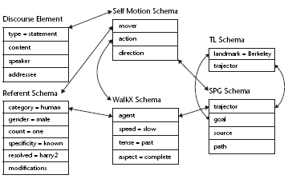
SemSpec for “Harry strolled into Berkley”

Slide 18
“Harry”
Lexical construction Harry
subcase of NP
form “Harry”
meaning Referent Schema
type <-> person
gender <-> male
count <-> one
specificity <-> known
resolved <-> harry2

Slide 19
SemSpec for “Harry strolled into Berkeley”
Notes:
Encodes noun phrase
We assume that the hearer knows the person
“He strolled into Berkeley” would be the same but resolved would be empty
Question “who strolled into Berkeley” can be represented with a value of “questioned” in the specificity role

Slide 20
“Strolled”
Lexical construction Strolled
subcase of Motion Verb, Regular Past
form “stroll+ed”
meaning WalkX
speed <-> slow
tense <-> past
aspect <-> completed

Slide 21
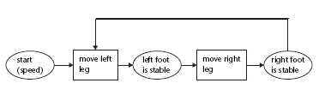
WalkX schema
Only single parameter controls the rate of moving one leg after the other
Leg moves only after the other is stable
  As opposed to running

Slide 22
SemSpec for “Harry strolled into Berkeley”
Notes:
Parameters – speed, when the action occurred, aspect – should the action be simulated as ongoing, completed, etc.?

Slide 23
“Strolled”
Lexical construction Strolled
subcase of Motion Verb, Regular Past
form “stroll+ed”
meaning WalkX
speed <-> slow
tense <-> past
aspect <-> completed
Notes:
Subcase of Motion Verb
We need construction to tie together the constituents that describe directed motion of one’s self

Slide 24
SemSpec for “Harry strolled into Berkley”

Slide 25
Self-directed motion
Construction Self-Directed Motion
subcase of Motion Clause
constituents
movA: NP
actV: Motion Verb
locPP: Spatial PP
form mover < action < direction
meaning Self-Motion Schema
mover <-> movA
action <-> actV
direction <-> locPP
Notes:
Self-directed clause made up from 3 constituents
One noun phrase, one motion verb and one spatial prepositional phrase
Form – ordering
Meaning : three roles – mover, action and direction

Slide 26
SemSpec for “Harry strolled into Berkley”
Notes:
Discourse element – says it is a statement, no other specification
Content is based on self-motion schema which links together actor (Harry), action (strolled) and direction (to Berkeley)
Mover agent and trajector are all the same entity

Slide 27
What is the difference between
ECG and other formal notations of gramar rules?
ECG’s formalized schemas are just a way of writing down hypothesized neural connections and bindings.
These schemas are connected to semantic specification (SemSpec).
The simulation semantics process uses SemSpec and other activated knowledge to achieve conceptual integration and the resulting inferences

Slide 28
“She sneezed the tissue off the table”
Normally “sneeze” is intransitive
Traditional grammar would suggest separate word sense for sneeze as a transitive verb
ECG would need caused motion construction
Construction Caused Motion
subcase of Motion Clause
constituents
causer: Agent
action: Motion
trajector: Movable object
direction: SpatialSpec
form causer < action < trajector < direction
meaning Caused Motion Schema
causer <-> action.actor
direction <-> action.location
Notes:
The construction introduces the possibility of a direct object (the extra role of trajector) for a normally intransitive verb.
It is a general rule, it doesn’t have to be learned separately for each word – we don’t need to know the other transitive sense of the word sneeze.
We can use it transitively with a certain construction.

Slide 29
“She opened and drank an expensive large beer”
In traditional view “opened” refers to one sense of beer while “drank” to another
“Beer” sometimes stands for a “container of beer”
In ECG we use measure phrase construction
  Construction Measure NP
  subcase of NP
  constituents
  m: Measure NP
  “of”
  s: Substance NP
  form m < “of” < s
  meaning Containment Schema
  vessel <-> m
  contents <-> s

Slide 30
4 basic formal structures to formalize cognitive linguistics
  Schema
  Construction
  Map
    metaphors
  Mental space
    Can formalize “Josh said that Harry strolled to Berkeley”
    Talking about other times, places, other people’s thoughts, etc.

Slide 31

Use of ECG
Computer understanding systems
  Narayanan (1997)
    Analysis of metaphors in news articles
    Used pre-processed semantics
  Bryant (2004)
    Program that derives semantic relations that underlie English sentences
    Later Bryant, Narayanan and Sinha combined the two models

Slide 32
Use of ECG
Human processing:
  What can ECG tell us about natural intelligence?
  Garden-path sentences
    “The horse raced past the barn fell”
    Narayanan et al. 1988 – computer model that gives detailed predictions of how various factors (frequency of individual words, likelihood that they appear in certain constructions, etc.) interact in determining the difficulty of a garden-path situation.
    “The witness examined by the lawyer turned out to be unreliable”
    “The evidence examined by the lawyer turned out to be unreliable”
  Chang (2006)
    Model how children learn grammar

Slide 33
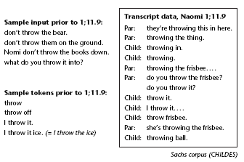
Learning constructions
Notes:
First – individual words
Next stage – 2 word combination
Simple sentences

Slide 34
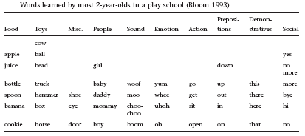
First words
Notes:
The nouns are all basic-level categories (except mommy and daddy)
Most of the nouns are experienced from both the agent and observer perspectives
Common sounds
Emotional states – expressions children learn and notice how they feel
Social- naming previously learned nonverbal acts of communication – already preverbal gestures
Indexical words – verbal equivalents of pointing or shared gaze
Actions and prepositions – more complex

Slide 35
Understanding prepositions
Image schemas
  Topological
    E.g. a container
  Orientational
    E.g. “in front of”
  Force-dynamic
    E.g. “against”
Reference object and smaller object
  Landmark and trajector
Notes:
Characterized in terms of landmark and trajector

Slide 36
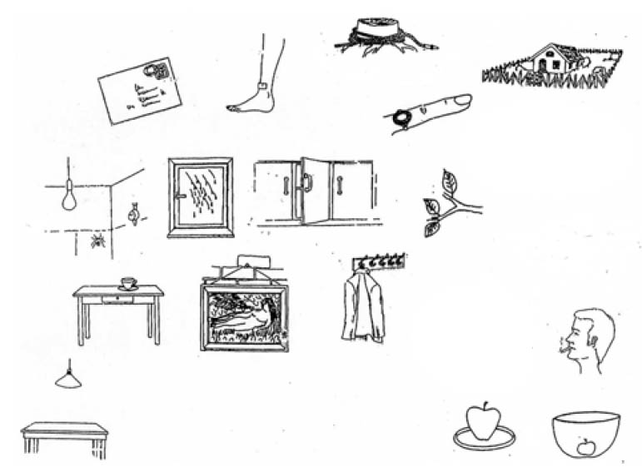
English
AROUND
ON
OVER
IN
Bowerman & Pederson
Notes:
On in English – all 3 schemas above, in contact with and supported by

Slide 37
Dutch
OP
OM
ANN
BOVEN
IN
Bowerman & Pederson
Notes:
Op – all 3 schemas
Only contact and support “ann”

Slide 38
Chinese
ZHOU
LI
SHANG
Bowerman & Pederson
Notes:
In chinese support not important…
Image schemas are universal, but the mapping to specific preposition can be different in different languages

Slide 39
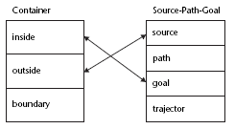
“Into” binds inside to a goal
Notes:
Standart way to diagram these schema relations by multislot boxes.
Double headed-arrows are conceptual links – depict graphically the facts that the exterior of the container is the source and the interior the goal.
“Out of” – exterior <-> goal
“through” – exterior <-> source, goal, interior <-> path

Slide 40
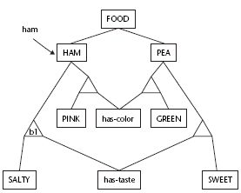
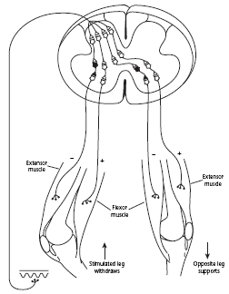
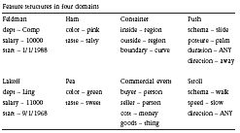
Levels of description
Language and thought
  “El jamón prueba salado“
Computational models
Connectionist networks
Neural systems

Slide 41
Reiger (1996)
Emulates a child viewing a simple geometric scene and being told a word that describes something about that scene
Has universal structure – visual system
  2 classes of visual features
    Quantitative geometric features (e.g. angles)
    Qualitative topological features (e.g. contact)
  Components
    Center-surround cells, edge-sensitive cells, etc.
Trained with a series of word-image pairs
Standard back-propagation learning
Later extended with motion prepositions (into, through, around)
Notes:
A program to emulate a child viewing a simple geometric scene and being told a word that describes something about that scene
Previous attempts to model acquisition showed that language cannot be all pre-wired (couldn’t capture cultural bias)
And cannot be tabula rasa (programs failed to learn the regularities so far)
This program has universal structure -> incorporated visual system
Is sensitive to 2 classes of visual features
Standard back-propagation learning – any weights that connect to the supplied correct answer will be made stronger and weights to alternative answers will be made weaker (implicit negative) – it supposes there is only one right answer.

Slide 42
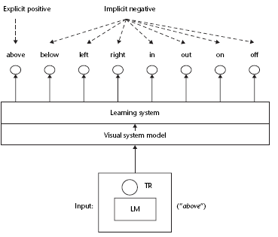
Model
Notes:
Limitations: it was great at recognizing but
couldn’t reason with the concept and couldn’t use it in an action
it recognized only most direct and literal use of word
deals only with single words (children get larger linguistic context)
supervised slow learning is not plausible – slowly adjusting weights – in children one shot learning

Slide 43
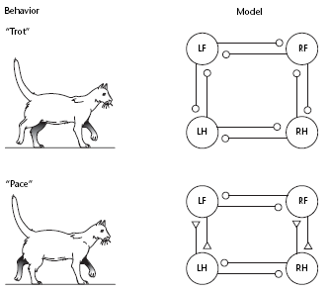
Action words
Children perform and plan actions long before they learn to describe them
Idea of characterizing actions by parameters
  Motor control has its hierarchy
    Lower level
      Coordination, inhibition
    Higher level
      Desired speed
  We can create abstract neural
  models of motor control
  systems
    executing schemas
Notes:
A motor action involves many coordinated neural firings, muscle contractions and other elements, but we have no conscious awareness of these details. What we CAN be aware of are certain parameters of the action -> force, direction, effector, posture, repetition, etc.
Language label only the action properties of which we can be aware => fixed set of experienced features determine the semantic space for any set of embodied concepts

Slide 44
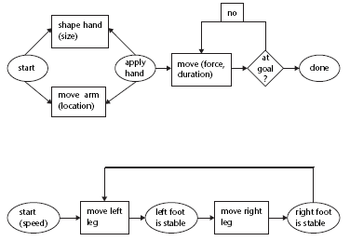
“Push” and “walk” schemas
Notes:
On the higher level we only need to know certain parameters (size, location, speed).

Slide 45
Bailey (1997)
Child learning of action words
  Performing an action and hearing her parent’s label
Restricted to actions that can be carried out by one hand on a table

Slide 46
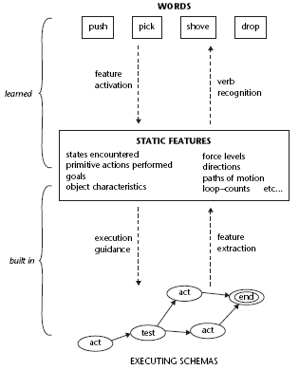
Model
Intermediate set of feature structures
  Parameterization of action
  Chosen to fit the basic X-schemas
Bi-directional arrows
  Labeling pathway
  Command pathway
Notes:
People may not have access to the elaborate neural networks that coordinate our actions
What we can consciously know about our own actions can be described by a relatively small number of features.

Slide 47
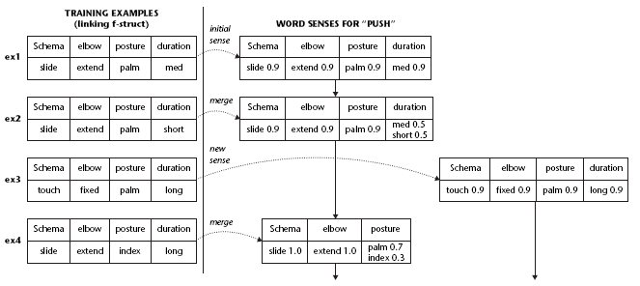
4 steps in learning “push”
Notes:
Model merging – computational equivalent of recruitment (one-shot) learning:
In every case, the top row shows the names of features and the bottom row the given or predicted fillers for each feature. E.g. elbow motion can have values extended or fixed.
LH- four episodes, RH –programs guess
In first case, first model is just what robot did.
When it hears the same word after doing a push of much shorter duration, it revises its idea of the meaning to capture the fact that the duration seems equally likely to be short or medium…
Program keeps track of the various situations involving each word – can learn required correlations
Problem – when to learn a distinct new sense of a word – evaluating competing mental models
2 evaluation factors : how complex the model is (simpler the better)
How well model explains the data
-> the program introduces a new word sense when the extra complexity added to the vocabulary is more than balanced by each definition being a better fit to its subset of the scenarios.

Slide 48
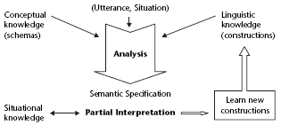
Chang (2006)
Model how children learn their first rules of grammar and generalize them in more adult-like rules
Notes:
Now we know how a child can learn single words, nouns, prepositions and action verbs. But how does it learn grammar?
The child will often not fully understand the utterance but knows quite a lot about the situation and therefore what the utterance might be about.

Slide 49
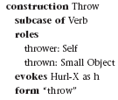
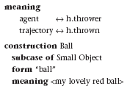
“You throw the ball”
Suppose the child knows lexical construction for words “throw” and “ball”
But does not know construction for the phrase “throw ball”
Notes:
Ball – child believes that “ball” refers to her toy and knows it is a small object.
Throw – child has learned that the sound “throw” is identified with a motor routine (X-schema) that she can carry out (she knows that action can be carried out by an agent)

Slide 50
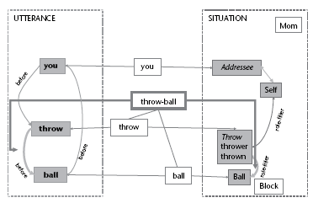
Notes:
RH-side: (SemSpec) situational knowledge – her mother is talking to her and she has just thrown her ball
She knows who/what the thrower (herself) and thrown (the ball) are.
If the sentence is understood, there should be a close correspondence between the meaning of the sentence and the current situation
LH-side – child knows the order of the words.
The important step is then she (subconsciously) compares what she knows to be true with what she understands to have been said.
Namely we are interested in how she might postulate the throw-ball construction and its links.
She might well guess (subconsciously) that the thing being thrown is specified in English by coming after the word “throw”

Slide 51
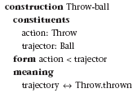
New grammar rule
She learned that the second word determines which object fills the thrown role of a throw action
Only later learns generalization of this construction that works for any transitive verb

Slide 52
Grammar learning
Key to understanding grammar acquisition is not the famous poverty of stimulus but rather the richness of the substrate
  Child already has rich base of conceptual and embodied experience
The reason why understanding is ahead of production
  Child can understand complex sentences by matching constructions to only parts of the utterance
  Constructions are the same in both

Slide 53
No need for negative evidence
Decay of unused knowledge
  People always choose the set of constructions that best fits an input
  If you keep track of best matches and
    Increase the potential value of successful constructions
    Decrease probability of trying not-useful constructions
  There would always be a better choice
Best-match
  Given a sentence S and a grammar G, the best analysis is the one that maximizes the probability of sentence S being generated by grammar G
Notes:
Program chooses the best grammar rather than the fist one that fits the data. – overcoming of Gold’s theorem

Slide 54
Generalisation
Lifting (learning superordinate categories)
  Taking a collection of relations of similar form and replacing the common element with a parameter
    After learning that cows, dogs, horses and pigs all move and eat and make noises, a good learning system will postulate a category (animal) and just remember what goes in the category and what relations to apply to members
Occurs also in grammar learning
  Very early child generalizes e.g. throw-ball to other small objects
Notes:
Lifting – in learning superordinate categories

