Slide 1
Meaning in animals: evolutionary view
CSCTR Session 3
Dana Retová

Slide 2
Language as selective advantage
Main evolutionary theories
  Changes in biology
  Language brings with it the ability to convey information about prey or other food or about dangers of different sorts
  It is a result of sexual selection
  Language replaces the social grooming (Dunbar’s “gossip theory”, 1996)
  Language makes it possible to cooperate about future goals. (Gärdenfors, 2004)

Slide 3
Biological foundations
Descended larynx
  extends the length of the vocal tract
  expands the variety of sounds humans can produce
  HOWEVER
  Also in other animals during vocalization
    Red deer, dogs, goats
    Probably evolved for other reasons - exaggerating the apparent size of an animal

Slide 4
Food and women
Necessity to convey information?
Or substitute for grooming / chatting up females?
It is hard to tell…
Notes:
In the context of language, sexual selection amounts to a ‘chatting up’ theory of evolution. Yet in contrast to birds’ plumages, which in many cases are markedly flashier in males than in females, men and women have equal linguistic abilities. Burling argues that this unusual symmetry in a trait under sexual selection suggests a corresponding symmetry in choosing: males consider their choice of mate as carefully as females do. Such a scenario implies that some form of long-term partnership between parents has been the rule among humans for a very long time.

Slide 5
Different hypothesis?
Is there any difference between animal representations and human representations that could explain why they can’t learn a complete language?
What kinds of mental representations are required for language to evolve?

Slide 6
What are representations?
Representation is an individual phenomenon by which an organism structures its knowledge with regards to its environment. (Vauclair, 1990)
Animals use the incoming information as cues to “perceptual inferences,” which add information to what is obtained by the psychophysical transducers. That which adds information to sensory input I propose to call a representation.
  L. Kováč’s idea of embedding cognition
Notes:
First we have to ask what are representations?...
Kovac embedding

Slide 7
Another approach to evolution
L. Kováč (2003): Human consciousness as a product of evolutionary escalation of emotional selection (in Slovak)
  Suggests 3 types of creative evolutionary mechanisms:
    Retrograde
      Initial state F
      State 2 E -> F
      State 3 D -> E -> F
    Intercalary
      Initial state A -> Z
      State 2 A -> B -> Z
      State 3 A -> B -> Y -> Z
    Inventive
      Initial state A
      State2 A -> B
      State 3 A -> B -> C
Notes:
Retrograde, e.g. in metabolism of a cell, a certain aminoacid histidine is synthetized through 8 mediator steps to its precursor histidinol. In ancient organism the cell got its histidine from the environment. When it was all used up, a luckier organism that was able to synthetize histidine from histidinol by itself inside of the cell would have evolutionary advantage and produce more offsprings. In this way the whole synthetic pathway evolved.
Inventive – quite rare in biological evolution but dominates cultural evolution. Its rare because there is very little change that the random mutation will be functionally advantegous.
Intercalary – probably the main means how the complexity of cognitive mechanisms evolved.

Slide 8
Intercalation
Most simple cognitive systems:
  Moleculary cognition
    After reception of a signal, molecular receptor changes its conformation – can be viewed as molecular action (of transmitting the signal to other molecule).
  Intracellular cognition
    E. coli – registers attractants or repellents in its environment and reacts by moving towards or away from stimuli.
  Intercellular cognition
    Sensors and effectors are 2 different cells with intercalated nerve cells in between

Slide 9
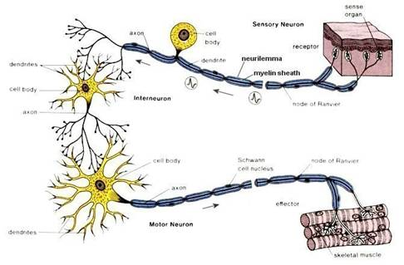
Intercellular cognition
Interneuron modulates the outcome according to the state of inner environment
Sensory information, primarily evaluated by the sensor is secondarily evaluated on a higher level
Past experience contributes to this evaluation
Also information from other sensors contributes
This kind of secondary processing of signal, refining of the evaluation by the receptor is in fact PERCEPTION

Slide 10
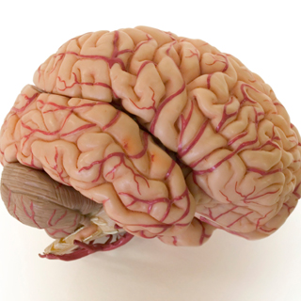
Perception is intercalated
Notes:
Evaluation process is always dichotomous: the signal is either “good or bad”. Those that have no such evaluation are neutral, therefore not perceivable. When the number of sensors in evolution increased, the perceptual information was not always complementary but also contradictory -> problem with choice of motoric program.
Emotions -> systems to ensure consitency, way to deal with contradictory actions => Supracellular cognition (core self?)
Thinking = abstract motoricity – Brain is testing out various motoric acts, but only computationally (in form of imagery)
Cogitation (thinking) is an abstract way of searching how to minimize unpleasant situations and maximize pleasure.
= abstractogenic cognition
LIFE: if we want to understand the semantic part of life, we have to look at evolution as historical process… we cannot disassemble meaning to physical subcomponents without knowing how they came about.

Slide 11
2 types of representations (Gärdenfors, 1996)
Cued
  Stand for something that is present in the current external situation of the representing organismn or triggered by something in a recent situation
    E.g. animal recognizes certain object as food, mate, etc.
Detached
  Stand for objects or events that are neither present in the current situation nor triggered by some recent situation
    Memory that can be evoked independently of the context where the memory was created
    Also “spatial maps”

Slide 12
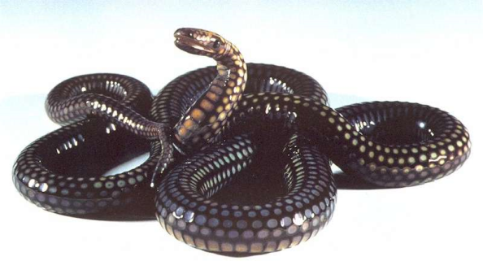

How can we tell them apart?
Probably there is no sharp distinction but more of a degree of detachment
e.g. capacity for representing object permanence involves some level of detachment
  Snake example (Sjölander, 1993)
Notes:
Snake does not have a central representation of a mouse but relies solely on transduced information. The snake exploits 3 different sensory systems in relation to prey.
When something is categorized as food (as opposed to mate) – cued representation.
We do not assume that the animal is aware of the representation, only that there is some generalizing factor that determines its behavior.
On the other hand a cat relies on combination from several sensors: eyes, ears, nose, whiskers,…
A cat predicts that a mouse will appear at the other side of a wall when it disappears on one side. It can “infer” information about the mouse even if there is no immediate sensory information. It has a detached representation of a mouse to some extent, independent of the information that is provided by the senses.
Degrees of detachment… Kovac’s idea of embedding -> molecular cognition, intercellular, supracellular cognition… the middle level is always adding some information according to its past experiences (ontogenetic or phylogenetic). E.g. at the top-most level, we are able to self-reflect or even use science to reflect on human nature – we can be aware of some cognitive biases or illusions and decide to counteract them.

Slide 13
What is the evolutionary advantage of detached representations?
Craik (1943):
  If the organism carries a “small-scale model” of external reality and of its own possible actions within its head, it is able to try out various alternatives, conclude which are the best of them, react to future situations before they arise, utilize the knowledge of past events in dealing with the present and future, and in every way to react on a much fuller, safer and more competent manner to the emergencies which face it.

Slide 14
Inner environment
Necessary for representing objects (e.g. food, predators, mates), places (where food or shelter can be found), actions (and their consequences), even when these things are not perceptually present
Collection of all detached representation of the organism
  All things the organism can actively “think” about
Necessary for planning, deception, self-awareness

Slide 15
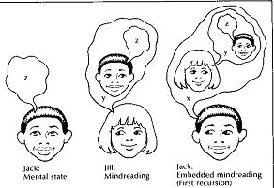
Theory of mind
Special case of representation of inner environment of another individual
Notes:
“I” experience preceded by “you” experience

Slide 16

Evolution of detached representations
Probably not before mammals
Crossmodal representations
  Multimodal information extraction of environmental information is likely to result in more veridical perception
  Cross-modal perception requires the derivation of modality-free information, a “representation”
  Categorization
    When a bird sees object as food, the bird’s brain is adding information about the perceived object
Notes:
When in evolution have detached representations appear?

Slide 17
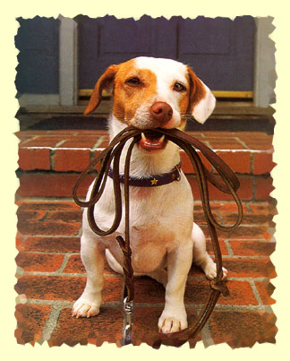
So what is missing in animal communication?
The predominant function of language is to communicate about that which is not here and now.
http://www.youtube.com/watch?v=ZwJaUFHs-C4
Notes:
A dog can say “I am hungry, I want water, I want to go out, I like you”, but it has no communicative means to say “I was hungry yesterday” not it can say: I will be angry if you lock me up tonight again. Likewise it can “say”: there is a rat here! But it cannot say: There is a rat in the next room.
How about dolphins? They seem to be able to understand symbolic representations for body parts (in the form of gestures)… more important action representations than object representation. Simple grammar. Also able to represent absence. Some planning problems that require detached representations.

Slide 18
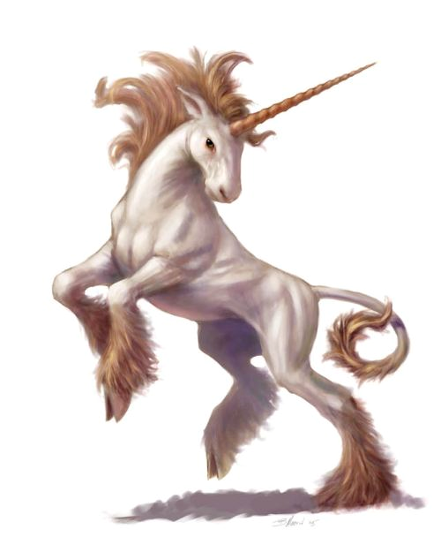
Notes:
Not only things displaced in place and time but also something that has no location in space at all and never happen at all.

Slide 19
What is missing?
Language is needed only to communicate your internal representation of what could be, what has been, and of those things and happenings that are not present in the vicinity = need for detached representations
We need them for planning
  Immediate – plans for present needs
  Anticipatory – plans for future needs
Notes:
To escape here and now, to anticipate and plan it needs a detached representation of a goal and a start situation and generating a representation of partially ordered set of actions for itself for getting from start to goal.
Is there anticipatory planning in animals? I would need a representation of myself in order to anticipate my needs at some other time.
Tool-making in chimps occurred only in the presence of a visible reward, and never without it. In the chimpanzee the mental range seems to be limited to present situations, with little conception of past or future.
Humans can predict that they will be hungry tomorrow and save some food…
For anticipatory planning it must have a detached representation of its future needs. Immediate planning only requires a cued representation of the current need.
Does this one have this or is it anthropocentric fallacy?

Slide 20
Planning
It needs representations of
  Goal and start situation
  Sequences of actions
  The outcomes of the actions.
They have to be detached otherwise it is not possible for the animal to choose different actions.
Planning presupposes inner world.
Notes:
An animal is planning its actions if it has representation of a goal and a start situation and is capable of generating a representation of a partially ordered set of actions for getting from start to goal.

Slide 21
Anticipatory planning
Animals only plan for present needs (?)
http://www.youtube.com/watch?v=dL5SGe7zSIc
Why is it so difficult?
  Indirect solution is overshadowed by the direct presence of a more attractive stimulus
  They cannot suppress their perception
  children <2
  To plan for future needs one must be able to represent potential needs (imagine future wishes)
Notes:
(Boysen, Berston, 1995) Chimpanzees are offered two piles of peanuts. One ape was to point at one of the pile and then that pile was given to the other ape. Even after many repetitions, ape always pointed to the bigger pile.

Slide 22
Thinking and language
Are there detached representations without language?
  YES (?)
  We simulate sequences of actions in our inner environment
  What kind?
Is there language without detached representation?
  NO
  We need detached representations - symbols
Notes:
Planning does not presume language.
Language presumes the existence of an inner world.
Seeing language as a cause of human thinking (as does Dennet 1991) is like seeing money as a cause of human economics (Tomasello 1999). Humans have been trading goods as long as they have existed. But when a monetary system does emerge, it makes economic transactions more efficient.
Hominids have been communicating since long before they had a language, but language makes the exchange of knowledge more efficient.
When money is introduced, a relatively stable system of prices emerges. Similarly, when liguistic communication develops individuals will come to share a relatively stable system of meanings, i.e. components in their inner worlds that communicators can exchange between each other.
=> Language fosters a common structure of the inner worlds of the individuals in a society.

Slide 23
Types of Sign
Remember from Session 1?
Indexical - causal or physical link - SIGNALS
Iconic - imitation, similarity - ICONS
Symbolic - arbitrary link - SYMBOLS

Slide 24
Symbols vs. signals
Signal evokes action appropriate to the presence of its object
Symbol – not a proxy for its object but more of a vehicle for the conception of object
  To conceive a thing or a situation is not the same as to “react toward it” overtly, or to be aware of its presence.
  In talking about things we have conceptions of them not the things themselves; and it is the conceptions, not the things, that symbols directly “mean”.
Notes:
In other words, signal refers to something in the outer environment while a symbol refers to the inner world.
Signal can be viewed as an instruction to behave, symbols involve reference and construal.
Thinking is internalized movement.

Slide 25
Symbols in cooperation
If the common goal is present in the environment (ants), no need of joint representation
If the goal is detached then a common representation must be produced before the action
  The inner worlds of the individuals must be coordinated.

Slide 26
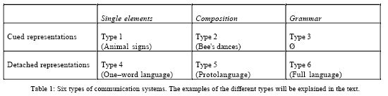
6 types of communication systems (Gärdenfors, 1993)

Slide 27
6 types of communication systems (Gärdenfors, 1993)

Slide 28
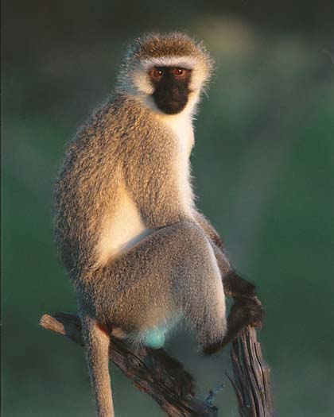

Vervet monkeys
3 different calls
  Eagle
  Leopard
  Snake
Only in presence of cue
Not capable of deception

Slide 29
6 types of communication systems (Gärdenfors, 1993)

Slide 30
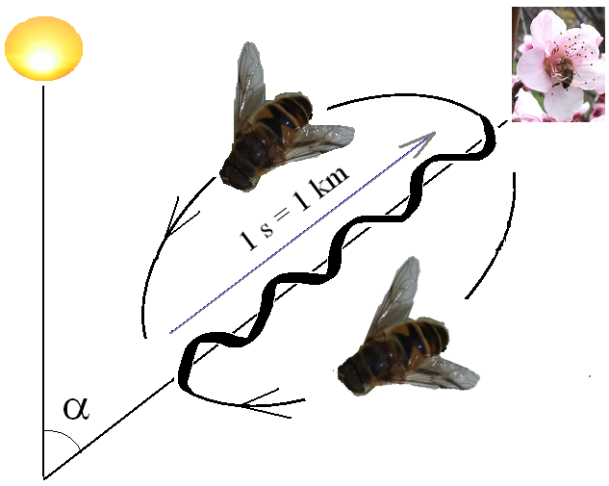
Bee dances
Notes:
Compositional but not symbolic: bees were never been observed to communicate about distances, directions, food sources, without actually coming from, or going to, a specific location.

Slide 31
6 types of communication systems (Gärdenfors, 1993)
Notes:
Single elements – we can also see it in young children
Compositional systems – two or more signs or symbols combined in a generative way
Problem with compositional systems -→ expressions composed of several elements are very ambiguous. “Danny hit” could mean that Danny hit something or Danny was hit. To disambiguate, we have to know the context. Also in kids up to 2yrs, apes, closet children, pidgin languages.
3) Systems with grammar: grammar helps disambiguate the meaning – much more context independent – more detached
Early mimetic stages (homo erectus) were system of iconic gestures and sounds (Donald 1991) - compositional.

Slide 32
Questions?

